Slide 1
Mutiple-Teams Tenant Direct Routing
Configuration Guide

Slide 2
Step 1 Create SubDomain

Slide 3
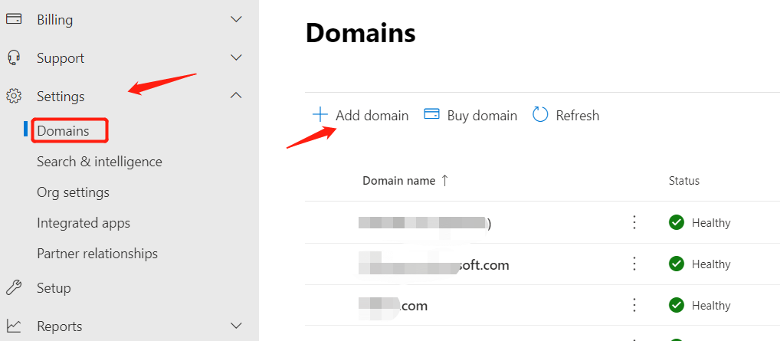
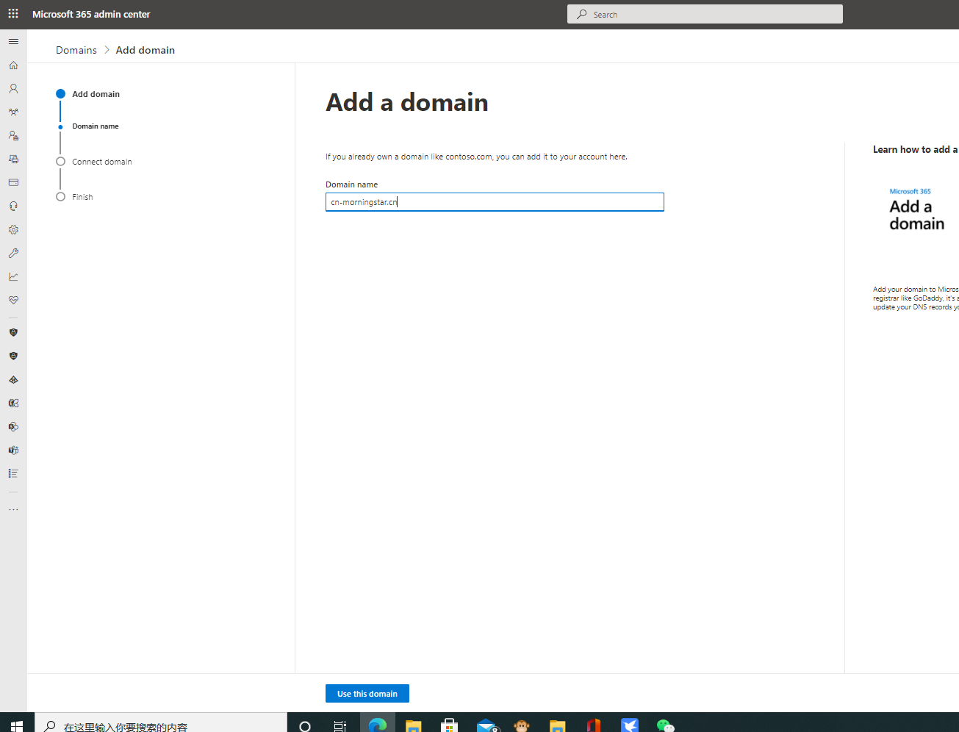
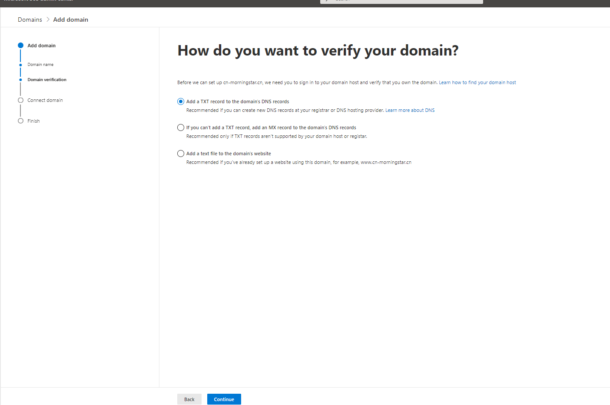
Add subdomain in Office 365
1. Log in to the administrator page of Office365 as an administrator and open the domain name setting option
2. Click Add domain name and add Subdomain as required
Subdomain:XXX.alc.aisesz.com—XXX—Customer Name
XXX. alc.aisesz.com
Choose option‘Add your own DNS Records’

Slide 4
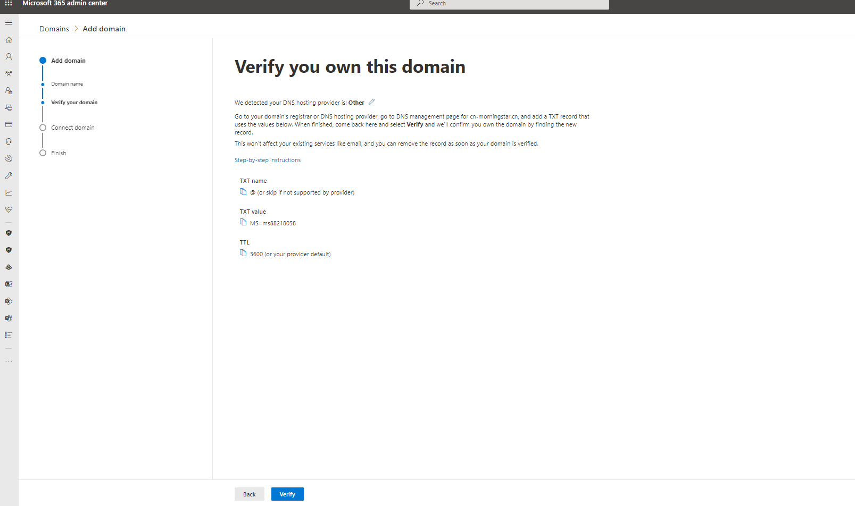
DNS Record SRV
The TXT Record value from Microsoft respond ,The customer must be send the Txt Record value to ChinaTelecom.Waiting for the ChinaTelecom add the Txt Record value to DNS Server, Once the chinaTelecom finished.The customer click the verify to next.
Send back the TxT name and TXT Value and TTL to us

Slide 5
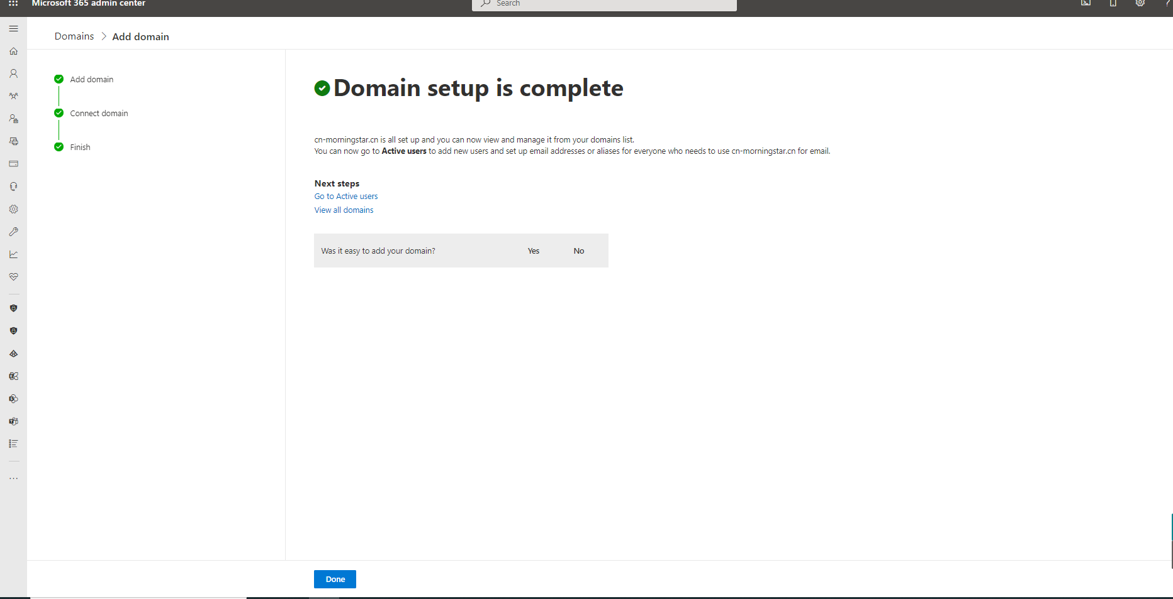
Do not select any Application(Exchange/Sharepoint/SFB),just click Next,then Click Done ,You can using ping to verify the subdomain
Ping can be used to verify whether subdomian parsing is successful,The public IP is 129.227.85.2,if no,maybe you need some time to wait the DNS Worked

Slide 6
Step 2 Create Active User

Slide 7
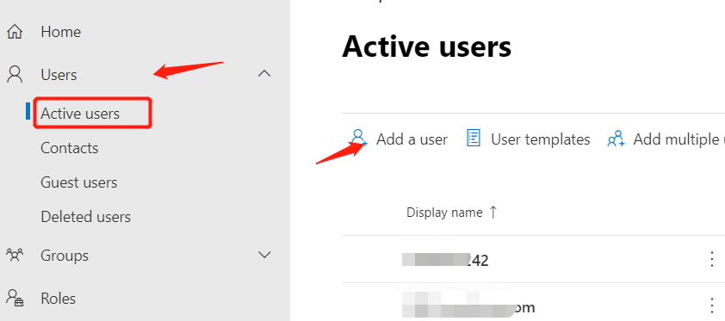
Step2：Create Subdomain User
1. In the Users TAB, click to open Active Users
2. Click Add User and select the Subdomain suffix
3. Assign the Office 365 license and Phone System license to activate the user
ActiveUser:
TeamsVoice@xxx.alc.aisesz.com

Slide 8
Step 3 Create DialPlan

Slide 9
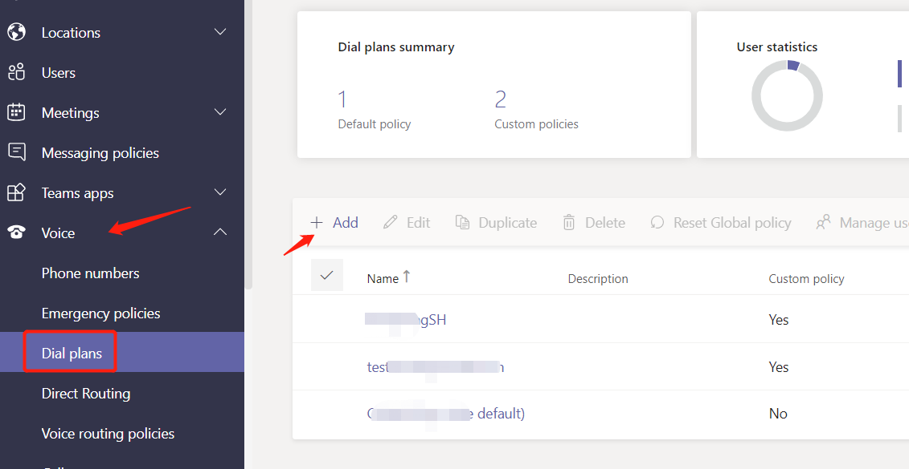
Step3：Create DailPlan
1. On the Teams management screen, tap Voice to open DialPlan
2. Click Add to add DialPlan
Note：DialPlan can be set based on user requirements. However, ensure that the dialed number is retained

Slide 10
Step3：Create DailPlan-Rules
Name | Patterm | Translation
LocalFixPhone | ^([2-8]\d{7}) | +86+Citycode$1 e.g:Suzhou:+86512$1,Shanghai:+8621$1
LocalMobile | ^(1\d{10})$ | +86$1
LongdisMobile | ^(01\d{10})$ | +86$1
LongdisFixPhone | ^0((([12]0|2[2-9])\d{5,8}|21\d{5,10}|[3-9][1-9]\d{5,9}|(701|90[1-9])\d{5,7}|80[2678]\d{5}|95\d{3}))\d*(\D+\d+)?$ | +86$1
Trollfree | ^([48]00\d{7}|10800\d{7})\d*$ | +86$1
Service | ^(999|1\d{2}|1\d{4}|9\d{4})$ | +86$1
Internationcall | ^(?:\+|00)(1|7|2[07]|3[0-46]|39\d|4[013-9]|5[1-8]|6[0-6]|8[1246]|9[0-58]|2[1235689]\d|24[013-9]|242\d|3[578]\d|42\d|5[09]\d|6[789]\d|8[035789]\d|9[679]\d)(?:0)?(\d{6,14})(\D+\d+)?$ | +$1$2
Operator Number+Extension | ^(\d{4})$ Extension=4digits | Operator Number;ext=$1(For example:+86512628888;ext=$1

Slide 11
Step 4 Create PSTN Usage

Slide 12
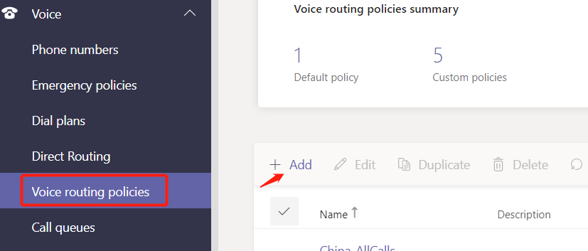
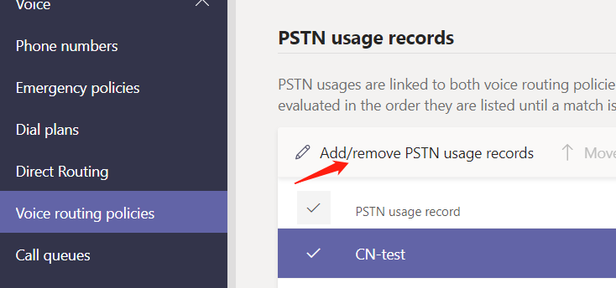
Step4：Create Voice Routing Policy
1. On the Page for creating a Voice Routing Policy, click Add
2. Add the CREATED PSTN Usage on the page that is displayed
PSTNUsage :customization

Slide 13
Step 5 Create Voice Routing

Slide 14
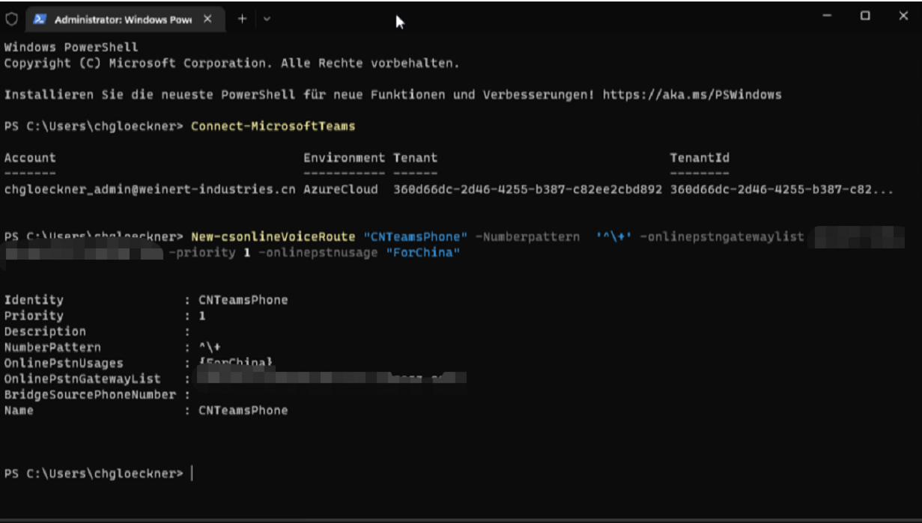
Step5：Create VoiceRouting
Notic:
PowerShell Version must be above 4.3
Connection Teams Server command Via Powershell
Install-Module MicrosoftTeams( if don’t have install the Teams Moudle on Powershell ,should be install the Teams module on powershell first)
Connect-MicrosoftTeams -Credential $credential (if installed theTeams module on powershell already,Can be use this CLI Command connectivity Teams Server directly)
New-csonlineVoiceRoute "customization" -Numberpattern '^\+' -onlinepstngatewaylist xxx.aisesz.com -priority 1 -onlinepstnusage “same the define pstnusage name"

Slide 15
Step 6 Assign the DID Number and Policies to Teams User

Slide 16
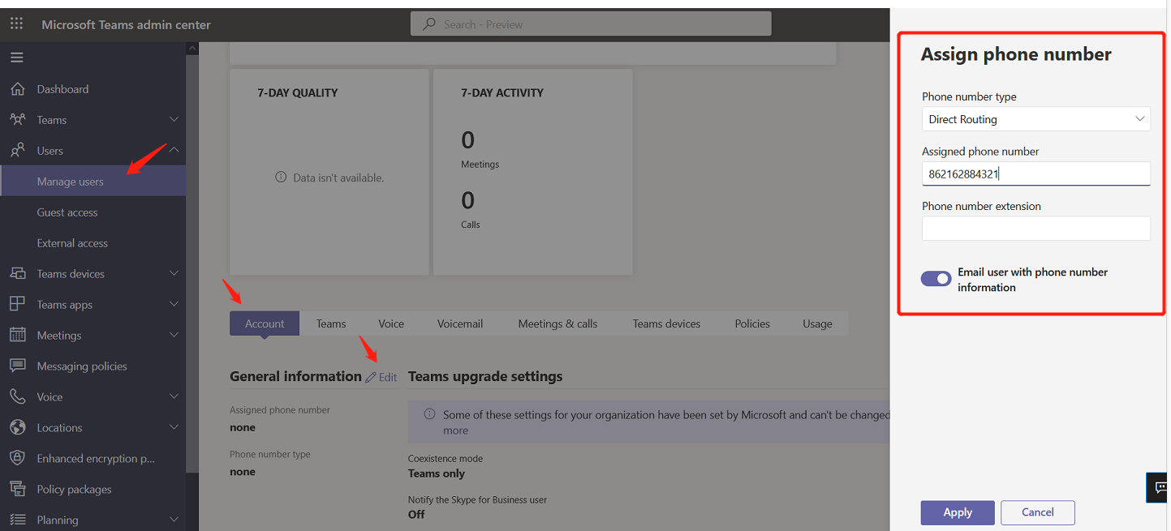
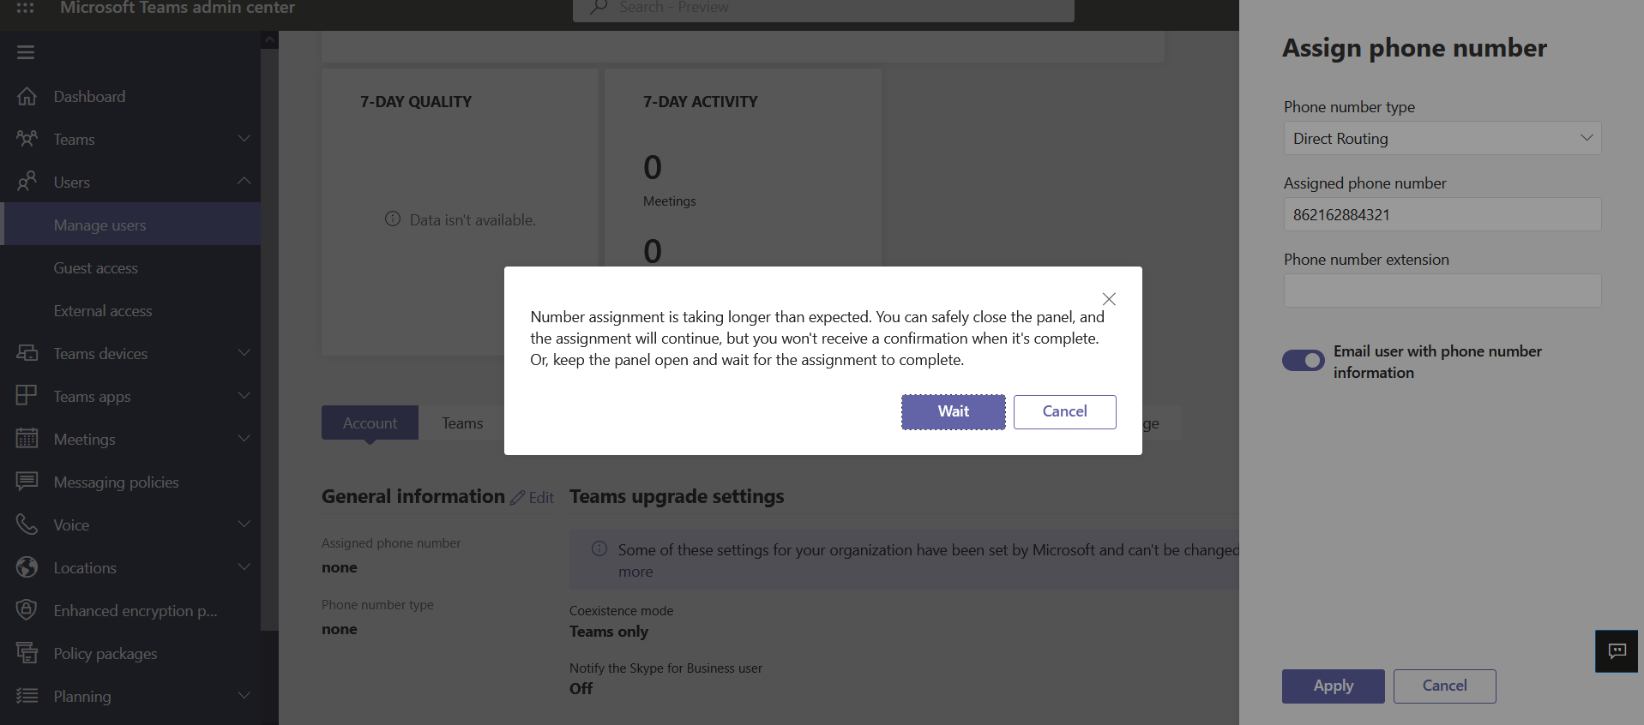
Step6：Assign the DID Number to Teams User
1 Go to Teams user panel ,and select the User
2、Select the Account ,and Edit, Set the DID Number
Notic
Teams only mode– You can use this configuration .
If the island mode-should be ask Microsoft that how to migration to only Teams mode.

Slide 17
Step6：Assign the DID Number to Teams User-Batch allocation number
1 Go to Teams user panel ,and select the User
2、Select the Account ,and Edit, Set the DID Number
Notic
Teams only mode– You can use this configuration .
If the island mode-should be ask Microsoft that how to migration to only Teams mode.

Slide 18
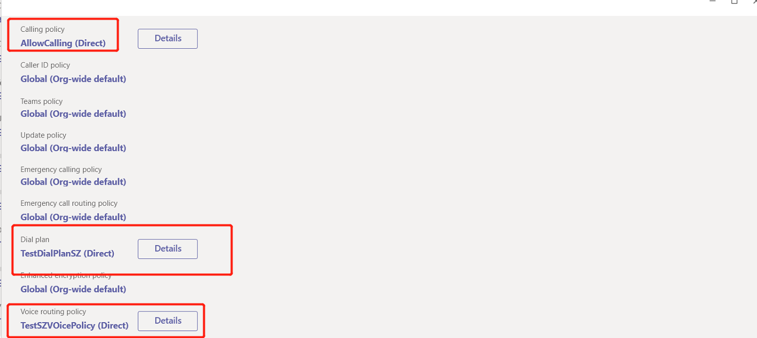
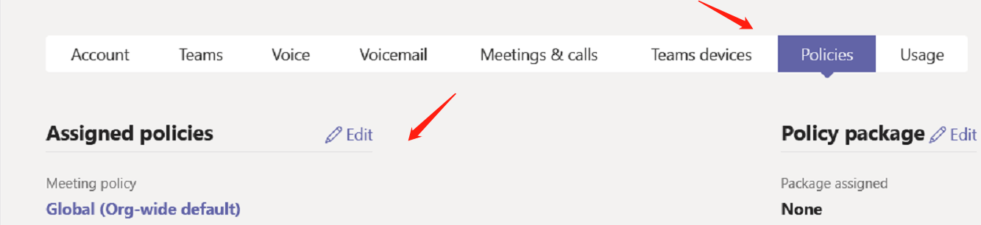
Step6：Assign policies to the Teams Phone System users
1 Go to Teams user panel ,and select the User
2、Select the Policies,,and Edit
Note：Make sure all users who use Teams voice have a Phone System license assigned to them

Slide 19
Step6：Assign policies to the Teams Phone System users-Batch allocation policies
1 Go to Teams user panel ,and select the User
2、Select the Policies,,and Edit
Note：Make sure all users who use Teams voice have a Phone System license assigned to them

Slide 20
Step 7 Verify the Dialpad on Teams Client

Slide 21
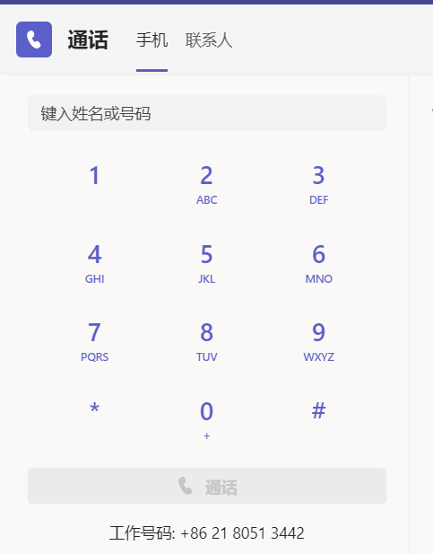
Step7：Verify the Dialpad on Teams Client
Normally: The DID number show the teams client ,if no ,you should be logout and login again ,or maybe you wait some time to waiting the Microsoft sync up

Slide 22
Outbound Rules
Usage | Format | Teams E164 Example | Remark
Teams Calling Party | +86512xxxxxxxxx | +8651262888002
Outbound Call Rule
Local FixPhone | xxxxxxxx 8digits-e.g:62881234 | +8651262881234
LongDis FixPhone | Area Code+Number-e.g:02162881234 | +862162881234
MobilePhone-Local MobilePhone-Longdistance | 1xxxxxxxxxx 11digits-18612345678 01xxxxxxxxxx 12digits-018612345678 | +8618612345678 +86018612345678
International Call | 00+Country Code+Number-e,g:0085262881234 | +85287654321

